Slide 1
FY23 CX Action Plan U.S. Fish and Wildlife Service Department of Interior
Completed Summer 2021

Slide 2
FY21 Capacity Assessment Reflection Summary
What we’re proud of this year:
Governance and Strategy
We have broadened internal coordination around digital service delivery through an ad hoc group that includes the National Wildlife Refuge System, Information Collection Clearance Officer, social science expertise, and Information Resource Technology Management. Our group formed an interagency team to write Department of Interior’ implementation guidance for the 21st Century Integrated Digital Experience Act (IDEA) FINAL DRAFT. We led the drafting the chapter on Customer Experience.
Service Design and Improvement
Over the last six months we have been consolidating and migrating content to a new Content Management System (fws.gov), which will greatly improve service delivery by ensuring customers can find information in a quick and more transparent fashion. A central CMS will also improve our ability to measure customer experience feedback.
We have secured funding to begin service design for two recreational user customer experience products.
A Customer Relationship Management application to manage limited use hunting and fishing opportunities on upwards of 118 field stations serving upwards or hundreds of thousands of hunters
A Visitor Experience Mobile App

Slide 3
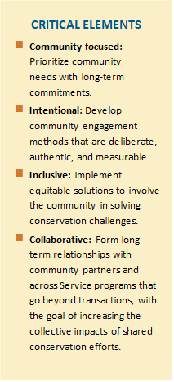
FY21 Capacity Assessment Reflection Summary
What we’re proud of this year:
Community-Centered Conservation in Urban Areas
With more than 100 national wildlife refuges within 25 miles of cities, the FWS established the Urban Wildlife Conservation Program ten years ago to improve access to nature for the 80% of Americans who live in cities. This program fosters long-term partnerships with historically marginalized communities and addresses racial inequality in wildlife conservation. This year we passed a couple major milestones. We finalized an agency-wide strategic plan that brings the vision of the Urban program to all Fish and Wildlife Service programs. We also designated one more flagship national wildlife refuge for a total of seven. Flagship sites are those that have reached key milestones in fully embracing and implementing Standards of Excellence and Critical Elements.
As a model for improving community engagement and strengthening local conservation outcomes, the Standards of Excellence have been embraced and validated as an effective framework for establishing genuine relationships between the Service and urban communities.
To expedite our ability to meaningfully engage with communities that have historically been excluded from conservation efforts, we are trying to model our behavior around four Critical Elements (see right). These four elements will be used as our foundation for building long-term partnerships; demonstrating our commitment to uplifting Black, Indigenous, and People of Color (BIPOC) communities; and holding ourselves accountable to continual progress.

Slide 4
FY21 Capacity Assessment Reflection Summary
Where we need to do better:
Measurement and Reporting
While we have relatively rigorous on-site visitor satisfaction surveys, we have been unable to apply any customer experience metrics to smaller discreet digital services due to the archaic state of digital infrastructure.
Governance and Strategy:
The mission of the agency is focused on wildlife conservation, and this single-minded focus can cumulatively be perceived as onerously regulatory and seeming disconnected from economic realities and popular recreation interests. While there is general agreement that applying customer service principles and incorporating social science research is necessary for successful wildlife conservation, it will take a top down and bottom-up culture shift to wholistically think about how we can help wildlife AND people thrive.
Customer Understanding:
Due to continued lack of capacity, it has been difficult to find time to explore better understanding our customers. Additionally, OMB information clearance in the Department of Interior continue to slow many initiatives.

Slide 5
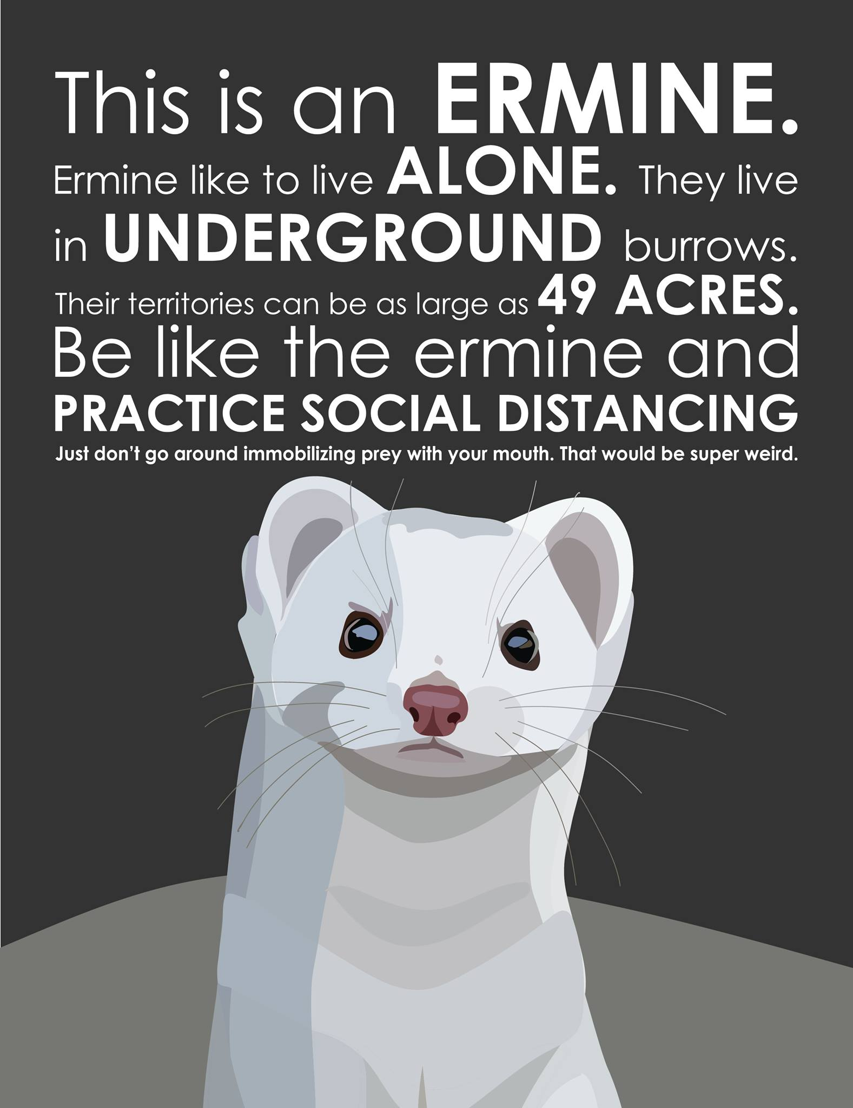
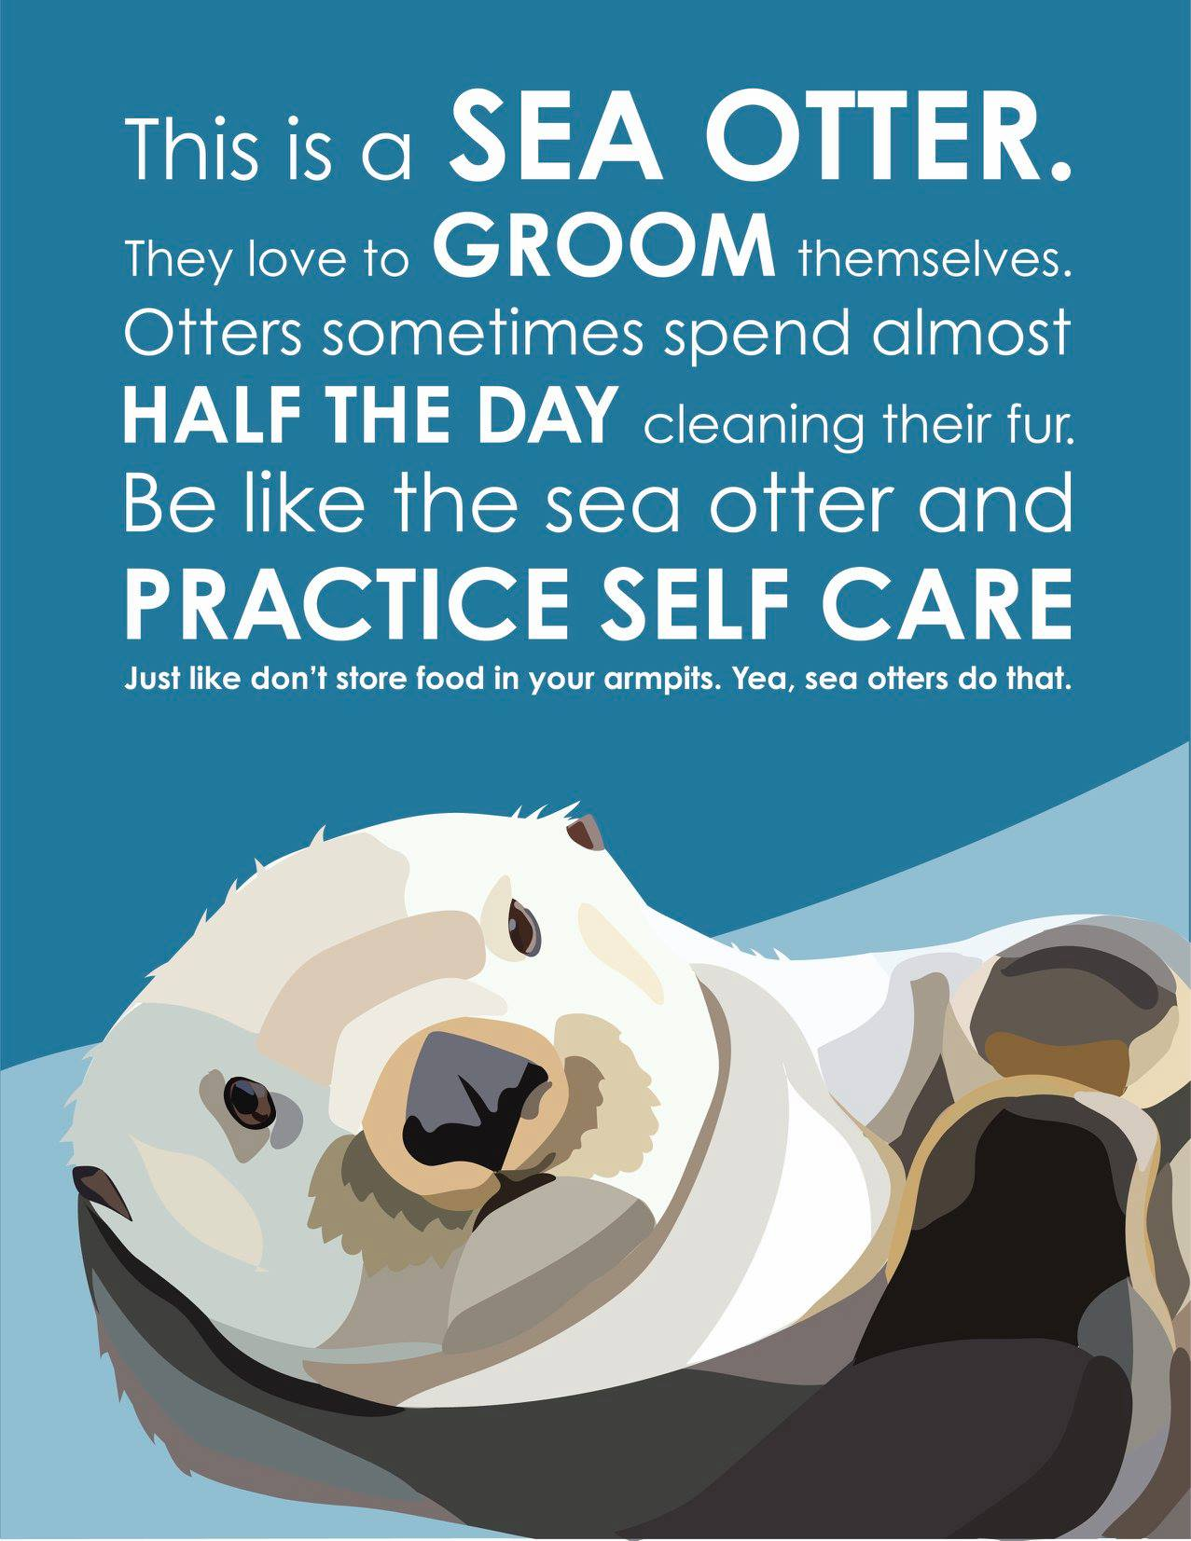
Adapting Service During a Global Pandemic
Where we innovated
National wildlife refuges saw unprecedented numbers of returning and new visitors during the COVID Pandemic. As the American public discovered national wildlife refuges, we implemented creative safety messaging through Recreate Responsibly messaging, as well as self-guided and virtual nature programming that served a school children and adults in lockdown.

Slide 6
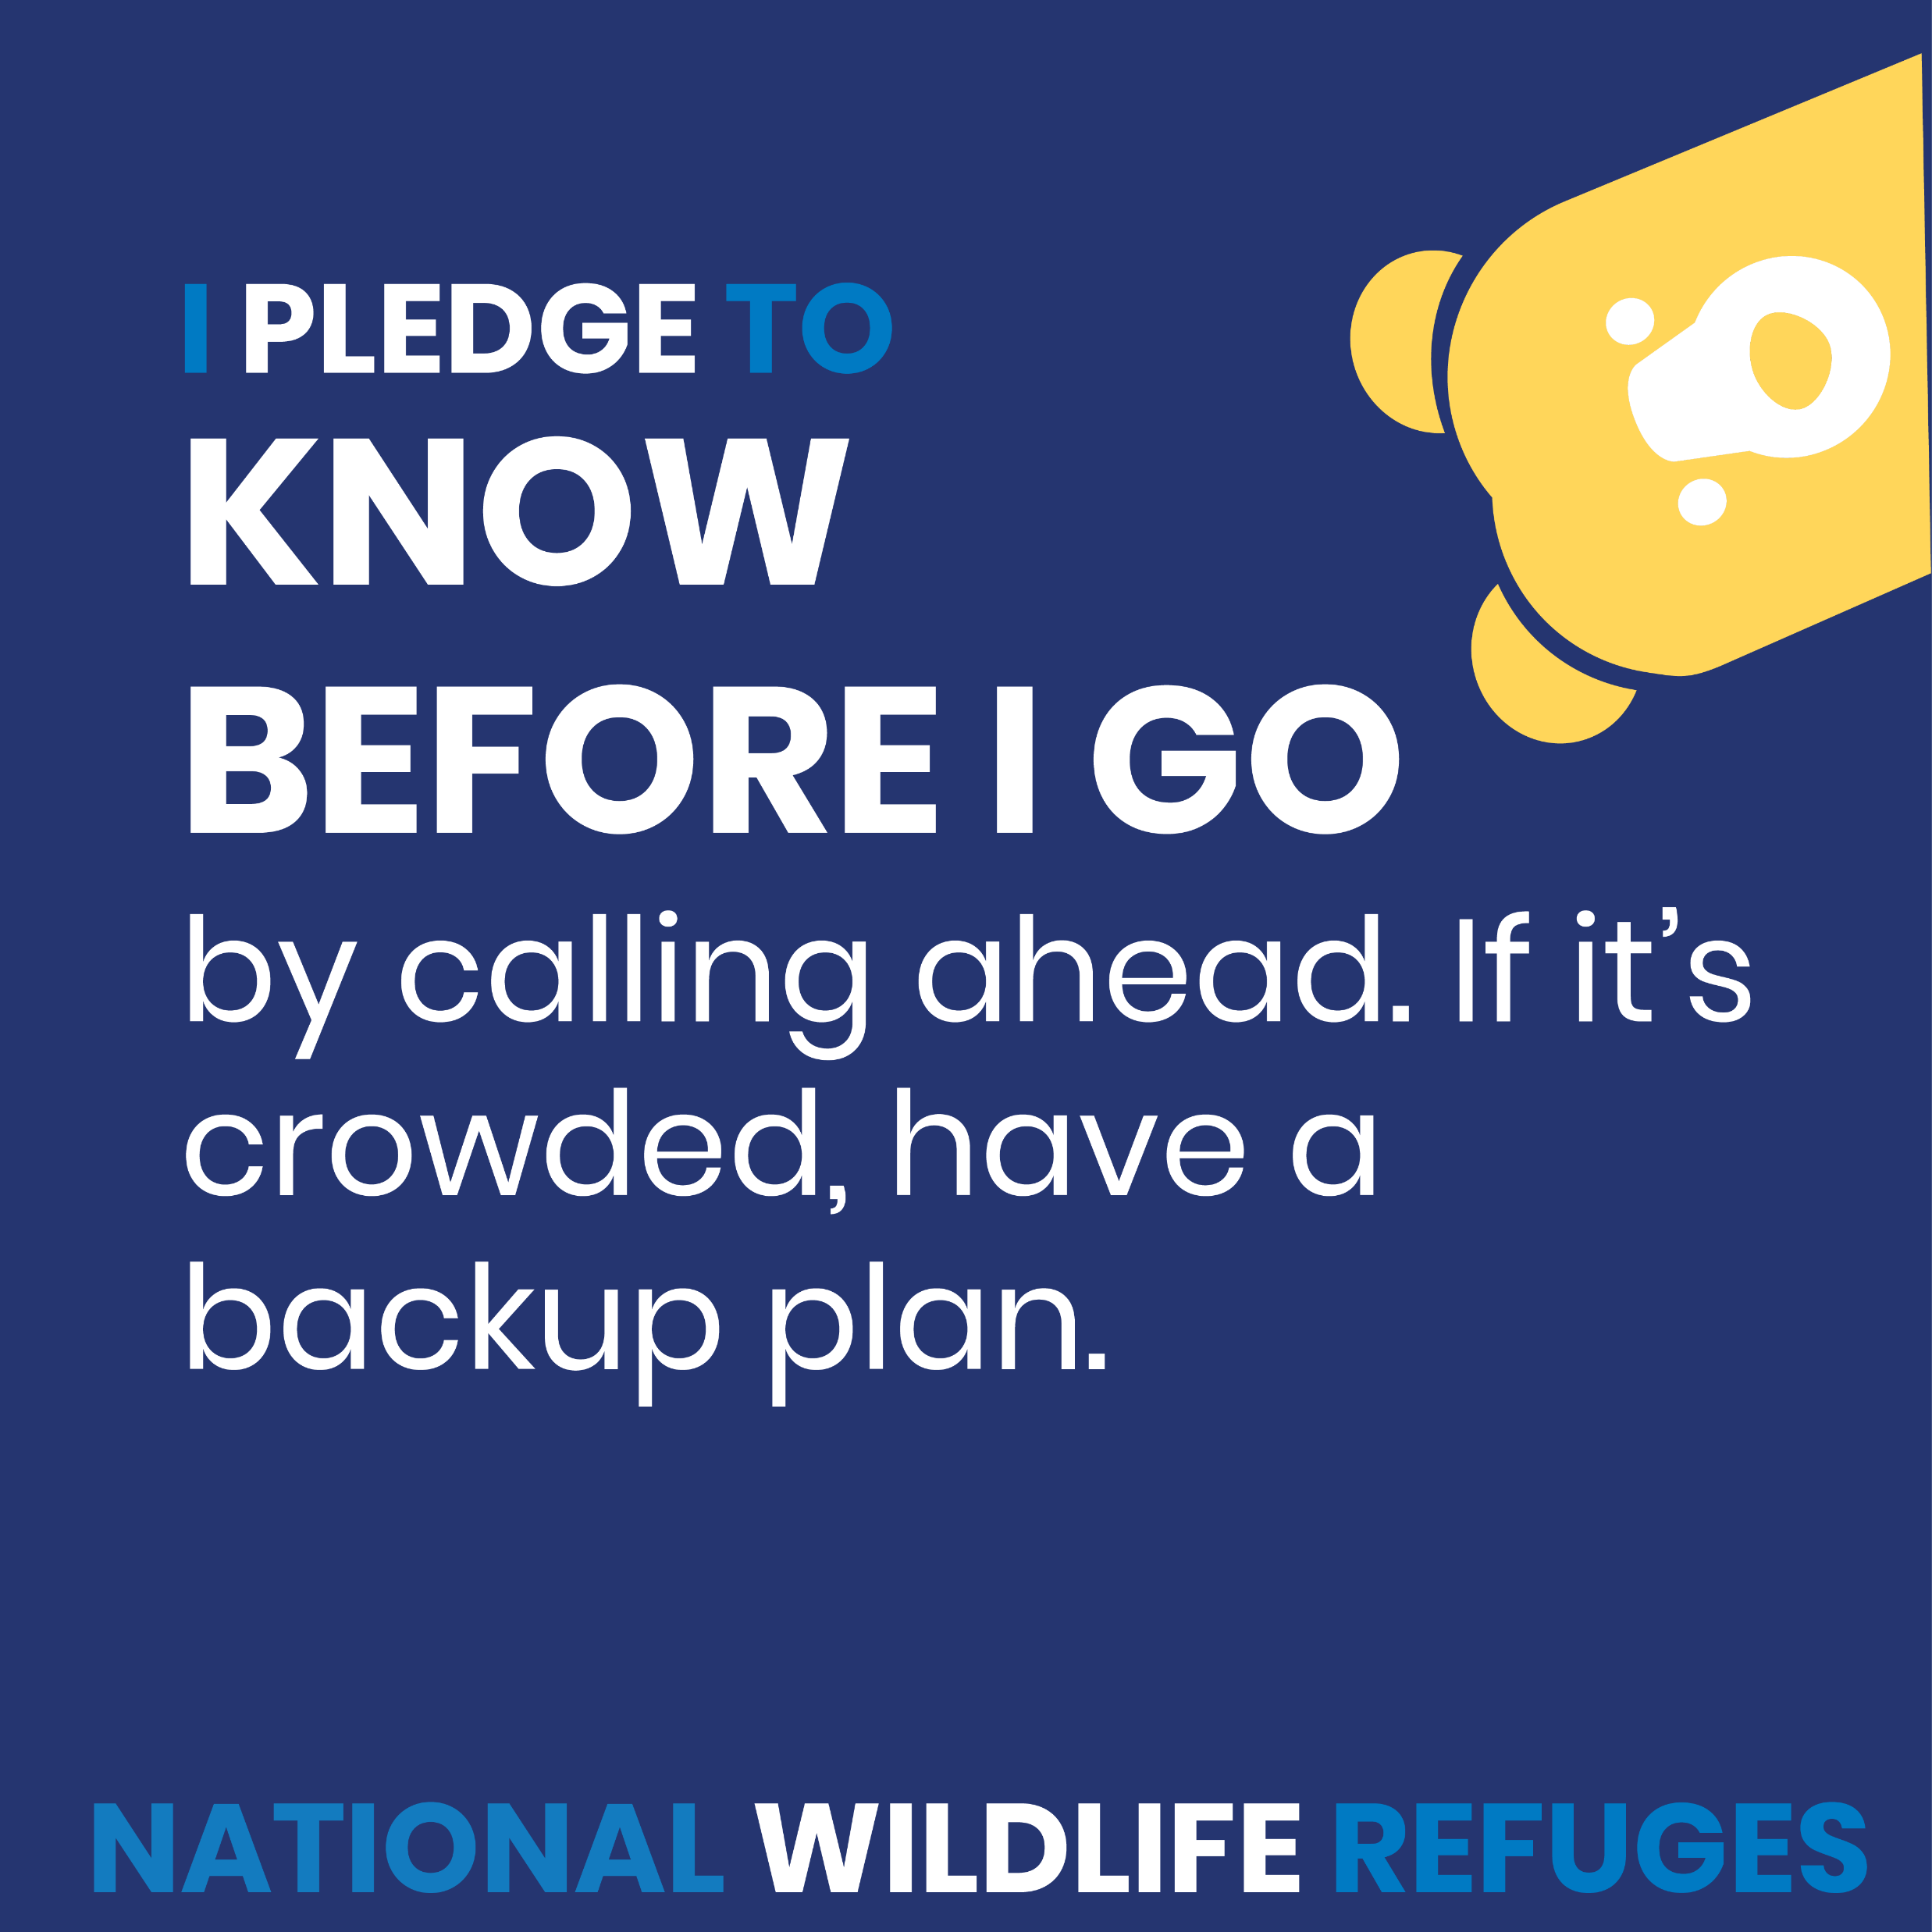
Adapting Service During a Global Pandemic
Examples of COVID Public Safety Messages

Slide 7
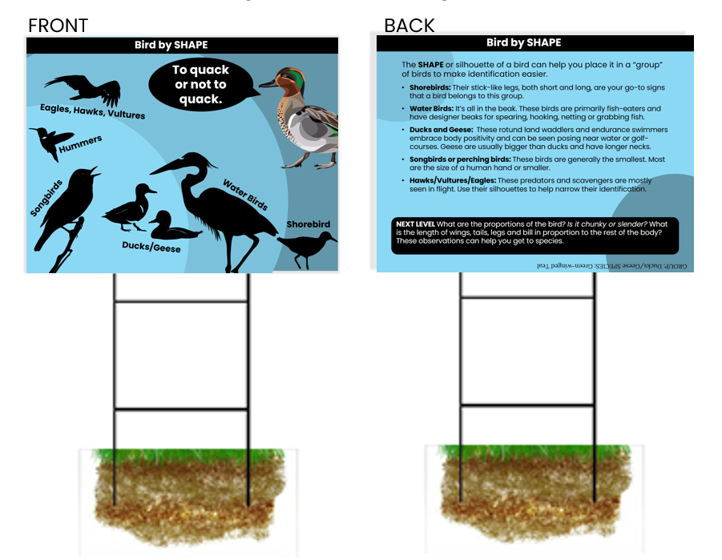
Adapting Service During a Global Pandemic
Examples of virtual and self-guided programming

Slide 8
HISP Equity Reflection
Who is this provider intended to serve?
Our customers can be roughly divided into three groups
Conservation Stakeholders: Individuals, private business, non-profits, Tribes, local and state governments who are impacted by regulatory or land management actions as well as those who seek our assistance for proactive conservation through grants and technical assistance.
The public lands areas of the U.S. Fish and Wildlife Service, most notably the National Wildlife Refuge System, serves:
Communities near or adjacent to public lands and impacted by management decisions
There is no one-size-fits-all solution to fish and wildlife conservation. National Wildlife Refuge System teams work to understand individual conservation issues as they affect the interests of local communities and groups. Then they customize approaches to address these needs to help fish, wildlife and people.​ While every field unit serves their local communities. In the last seven years, the Refuge System has made a numerous strategic investments to ensure our local urban communities reap the equitable benefits of wildlife conservation at over 101 national wildlife refuges within 25 miles of populations of 250,000+.
Recreational Visitors
The National Wildlife Refuge Visitor Survey data shows that the majority of Americans visiting wildlife refuges are primarily older, white, and college educated. This data supports the need to make wildlife refuges more welcoming and inclusive to all people and promote communication channels for reaching minority groups. Robust monitoring will allow us to take a science-based approach to achieve our goals around safe, welcoming and inclusive experiences.

Slide 9
HISP Equity Reflection (cont.)
Are there barriers that people of color, people with disabilities, LGBTQ+ people, women, non-native English speakers, and others who have been historically underserved, marginalized, discriminated, and adversely affected by persistent poverty and inequality face with regard to this program or service? How might these individuals interact with your program differently?
One barrier for many is lack of awareness about the services and benefits delivered by our agency. Others may be encounter skill, time or financial barriers in particular to a few of our higher investment recreation activities. For communities near national wildlife refuges, there may be physical barriers like public transportation availability or road safety. Fear of law enforcement, wildlife or natural areas could also be barriers for some groups. The FWS also recognizes the systemic effects of historically excluding underserved, marginalized, discriminated from outdoor recreation on public lands.
Where do we have a knowledge gap about individuals’ interactions with our service we need evidence to fill?
We don’t have any information about why certain groups do not visit national wildlife refuges.

Slide 10
FY22 Commit to Action: Launch of New Website (fws.gov)
What customer need will this action address?
Information delivery that facilitate a host of services ranging from simple school report on an endangered species to trip planning to grant application to simply contacting a nearby field office by phone or email.
Why is this a priority?
Our website receives over a 100 million views annually and is the primary customer service delivery platform for the U.S. Fish and Wildlife Service. It does not to adhere to any modern standards for accessibility, search engine optimization, or search. Site visitor regularly encounter outdated information, broken links, inaccessible content and non-sensical overwhelming site navigation.
Who is responsible for this action happening?
Information Resources and Technology and External Affairs with content migration support from the National Wildlife Refuge System, Division of Visitor Services and Communications
What action(s) / deliverables / milestones will you take / hit between Oct. 1, ‘21 – Sept. 30, ‘22?
Secure and migrate to new cloud provider
Series of content migration sprints to update outdated content, and consolidate into more user-friendly searchable interface.
Consolidate image management to serve public domain photos and documents for research, media and the public
Integrate Touchpoint CX feedback form and CX standard question across the site
Rigorous Use testing and fine tuning
Launch Site in alignment with 21st Century Integrated Digital Experience Act (IDEA)
How will you measure whether these actions had their intended effect?
Web traffic increase
Customer feedback and response forms
What do you need to make this happen?
This project has been ongoing for seven years and we finally have a launch date set for FY22. The heavy lift during the last push will be content migration which is happening through a coordinated effort that touches all levels of the organization. Once the site is launched, we will need to ensure we are getting customer feedback to continually make improvements.

Slide 11
FY22 Commit to Action: Reduce Skills Barriers to Recreational Access Near Urban National Wildlife Refuges
What customer need will this action address?
Overcoming skills barriers that young adults in urban areas might have related to participation in priority public uses on national wildlife refuges: wildlife viewing, fishing, photography, hunting and participating in guided education or nature program. This need will be addressed through outdoor skills programming that centers on offering mentored and repeated touchpoints to increase the chance of life-long adoption.
We define outdoor skills centers as places that provide the skills, equipment, and social structure for participants to learn new skills and eventually adopt and enjoy outdoor recreation activities independently. Centers offer repeatable outdoor opportunities and the resources to learn new things.
Why is this a priority?
Through Administration’s Racial Equity initiatives, we want to dismantle barriers to participation in outdoor recreation by under-represented communities.
Who is responsible for this action happening?
The National Wildlife Refuge System Division of Visitor Services and Communications and Infrastructure Management
What action(s) / deliverables / milestones will you take / hit between Oct. 1, ‘21 – Sept. 30, ‘22?
Conduct inventory and assessment of outdoor skills programming with the FWS
Design Framework for Success and best practices
Pilot framework and associated activities at 10-20 urban national wildlife serving marginalized communities.
How will you measure whether these actions had their intended effect?
We will be working with social science professionals to design evaluation to determine the long-range efficacy of programming.
What do you need to make this happen?
Funds to support evaluation

Slide 12
FY22 Commit to Action: Migrate Special Use Permit Process to ePermits
What customer need will this action address?
Universities, business, non-profits, and individuals must secure a special use permit to conduct regulated activities on national wildlife refuges including commercial uses, research, and general activities. The National Wildlife Refuge System (NWRS) issues approximately 20,000 Special Use Permits each year. The new system will address the need for customers to apply for permits, pay fees, communicate with the correct Service staff member, and access their finalized permit.
_{Why is this a priority?}
Currently, permit applications are available to the public online as fillable .pdfs, but require applicants to download, print, sign, and mail or email applications to the field station The process of applying for and issuing Special Use Permits (SUPs) is still largely paper-based, labor-intensive, and inefficient for both the public and the Service. Other programs within the Fish and Wildlife Service integrated their permit processes into one digital system, ePermits, that provides one-stop service for all permits. We will be migrating multiple Special use Permits to this platform.
Who is responsible for this action happening?
Information Resource Technology Management and National Wildlife Refuge System
What action(s) / deliverables / milestones will you take / hit between Oct. 1, ‘21 – Sept. 30, ‘22?
Analyze and improve five permit workflows through discovery process with outside contractor
Secure contract to configure five workflows on the ePermits.
Beta test and monitor permit offerings
How will you measure whether these actions had their intended effect?
Touchpoint CX feedback and questions will be integrated into the platform
What do you need to make this happen?
We were able to fund the discovery phase of this contract, but the project will require ~$250,000 more to configure the platform for multiple permit types.

Slide 13
FY23 Commit to Action: Customer Relationship Management System of Hunting and Fishing Opportunities
What customer need will this action address?
Over 2.5 million hunters and 8 million anglers visited FWS public lands in 2020. To ensure stable wildlife populations and quality use of the resource, field stations need to limit use of popular areas and opportunities. This action will address a variety of reservation and lotteries processes that serve tens of thousands of hunters each year, most of which are cumbersome, complicated and change with little notice.
A new customer relationship management system that serves these limited use hunting and fishing opportunities will address the need for recreational visitors to have a transparent, equitable opportunity to apply for these limited use opportunities.
Why is this a priority?
Approximately 118 field stations currently deliver this process by hand or through a web application hosted by a handful of vendors. We have discovered that these vendors do not meet the necessary cyber security requirements (fed-ramp certification) to securely offer these services.
Who is responsible for this action happening?
National Wildlife Refuge System, Division of Visitor Services and Communications and Division of Natural Resources and Information Resource Technology
What action(s) / deliverables / milestones will you take / hit between Oct. 1, ‘22 – Sept. 30, ‘23?
Put out request for proposals from vendors
Work with awarded contract to on-board 5-40 stations on to the new platform
How will you measure whether these actions had their intended effect?
Review customer experience feedback analytics submitted by contractor
What do you need to make this happen?
We have secured FY2021 funding to pursue this project, but there are a number of contracting, cyber-security and privacy related internal processes that are likely to slow down adoption.

Slide 14
Commitments from Executive Order 14058
On December 13th, 2021 (after agencies originally developed these action plans as part of the FY23 budget formulation process), President Biden signed Executive Order 14058 on Transforming Federal Customer Experience and Service Delivery To Rebuild Trust in Government. Section 4 of this Order was developed by working with HISPs to identify specific improvements to their core services (many of which were proposed in their FY23 Action Plans), to lift up and energize their existing efforts, improving accountability and support.
For FWS, EO 14058 commitments include:
redesign the website of the Fish and Wildlife Service, FWS.gov, in compliance with the 21st Century Integrated Digital Experience Act (Public Law 115-336), and shall support a centralized, modernized electronic permitting system to accept and process applications for permits.
Such a system might include special use permits for the National Wildlife Refuge System and for at least five high-volume permit application forms required for individuals and businesses who import or export fish, wildlife, and plants and their products internationally.
For more updates on agency progress on specific commitments, please visit https://www.performance.gov/cx/executive-order/.

Slide 15
https://performance.gov/cx

